Slide 1
(IMDCGD214-16YRD) Level 4/5 Group 15
Ben Reynolds Elliot Page Roberto Mitrea

Slide 2
Brief
Two Players
Adversarial
Physics Mechanic
Single Device

Slide 3
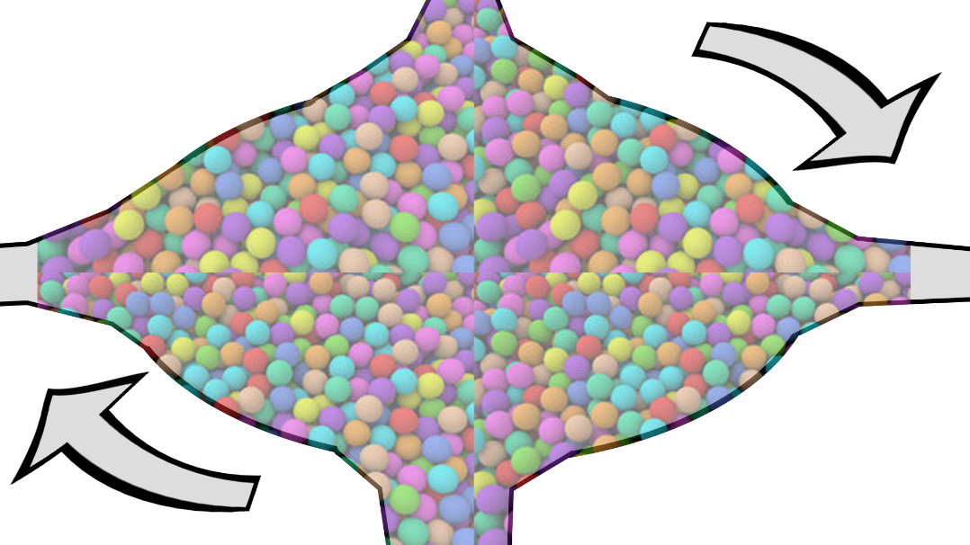
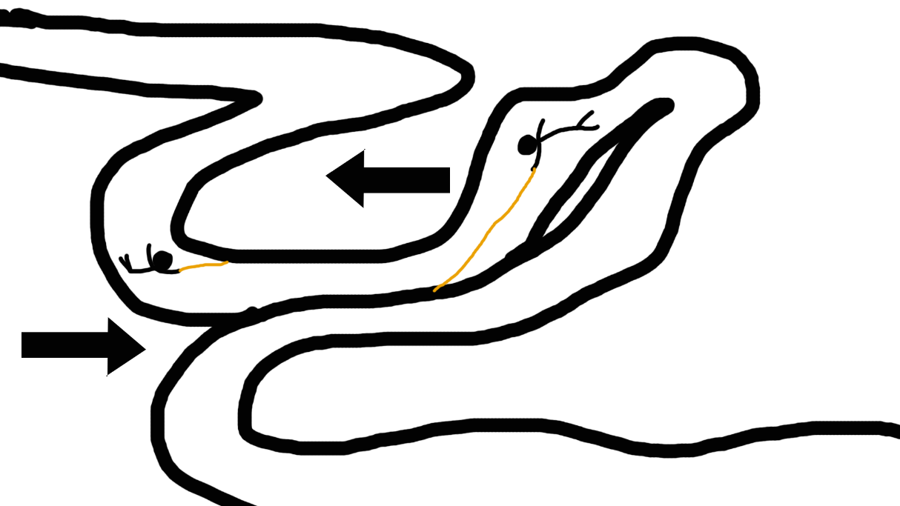
Initial Ideas

Slide 4
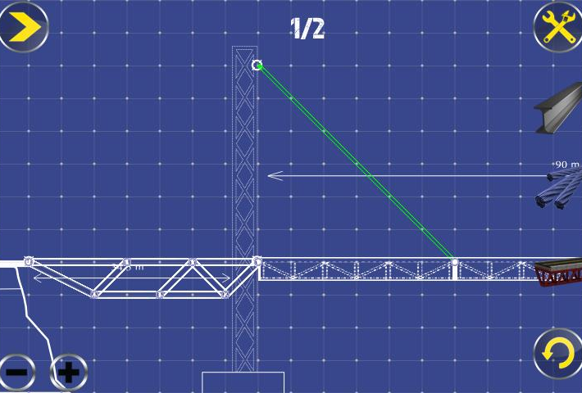
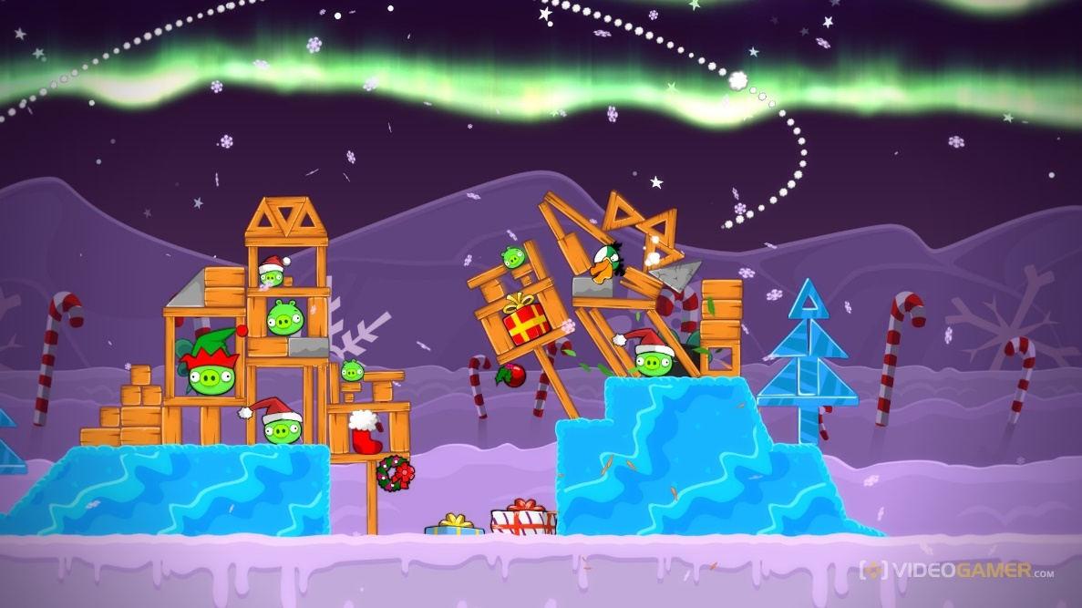
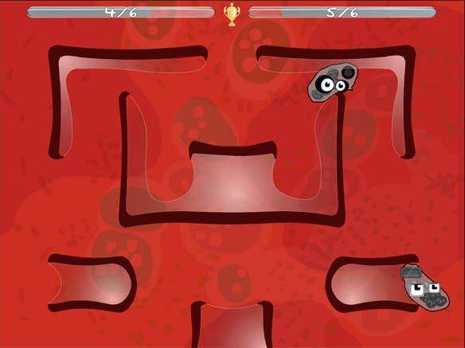
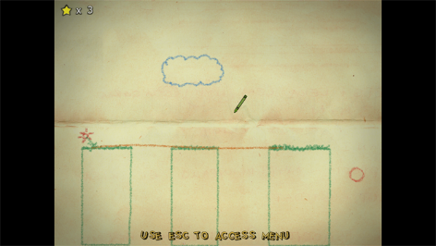
Research

Slide 5
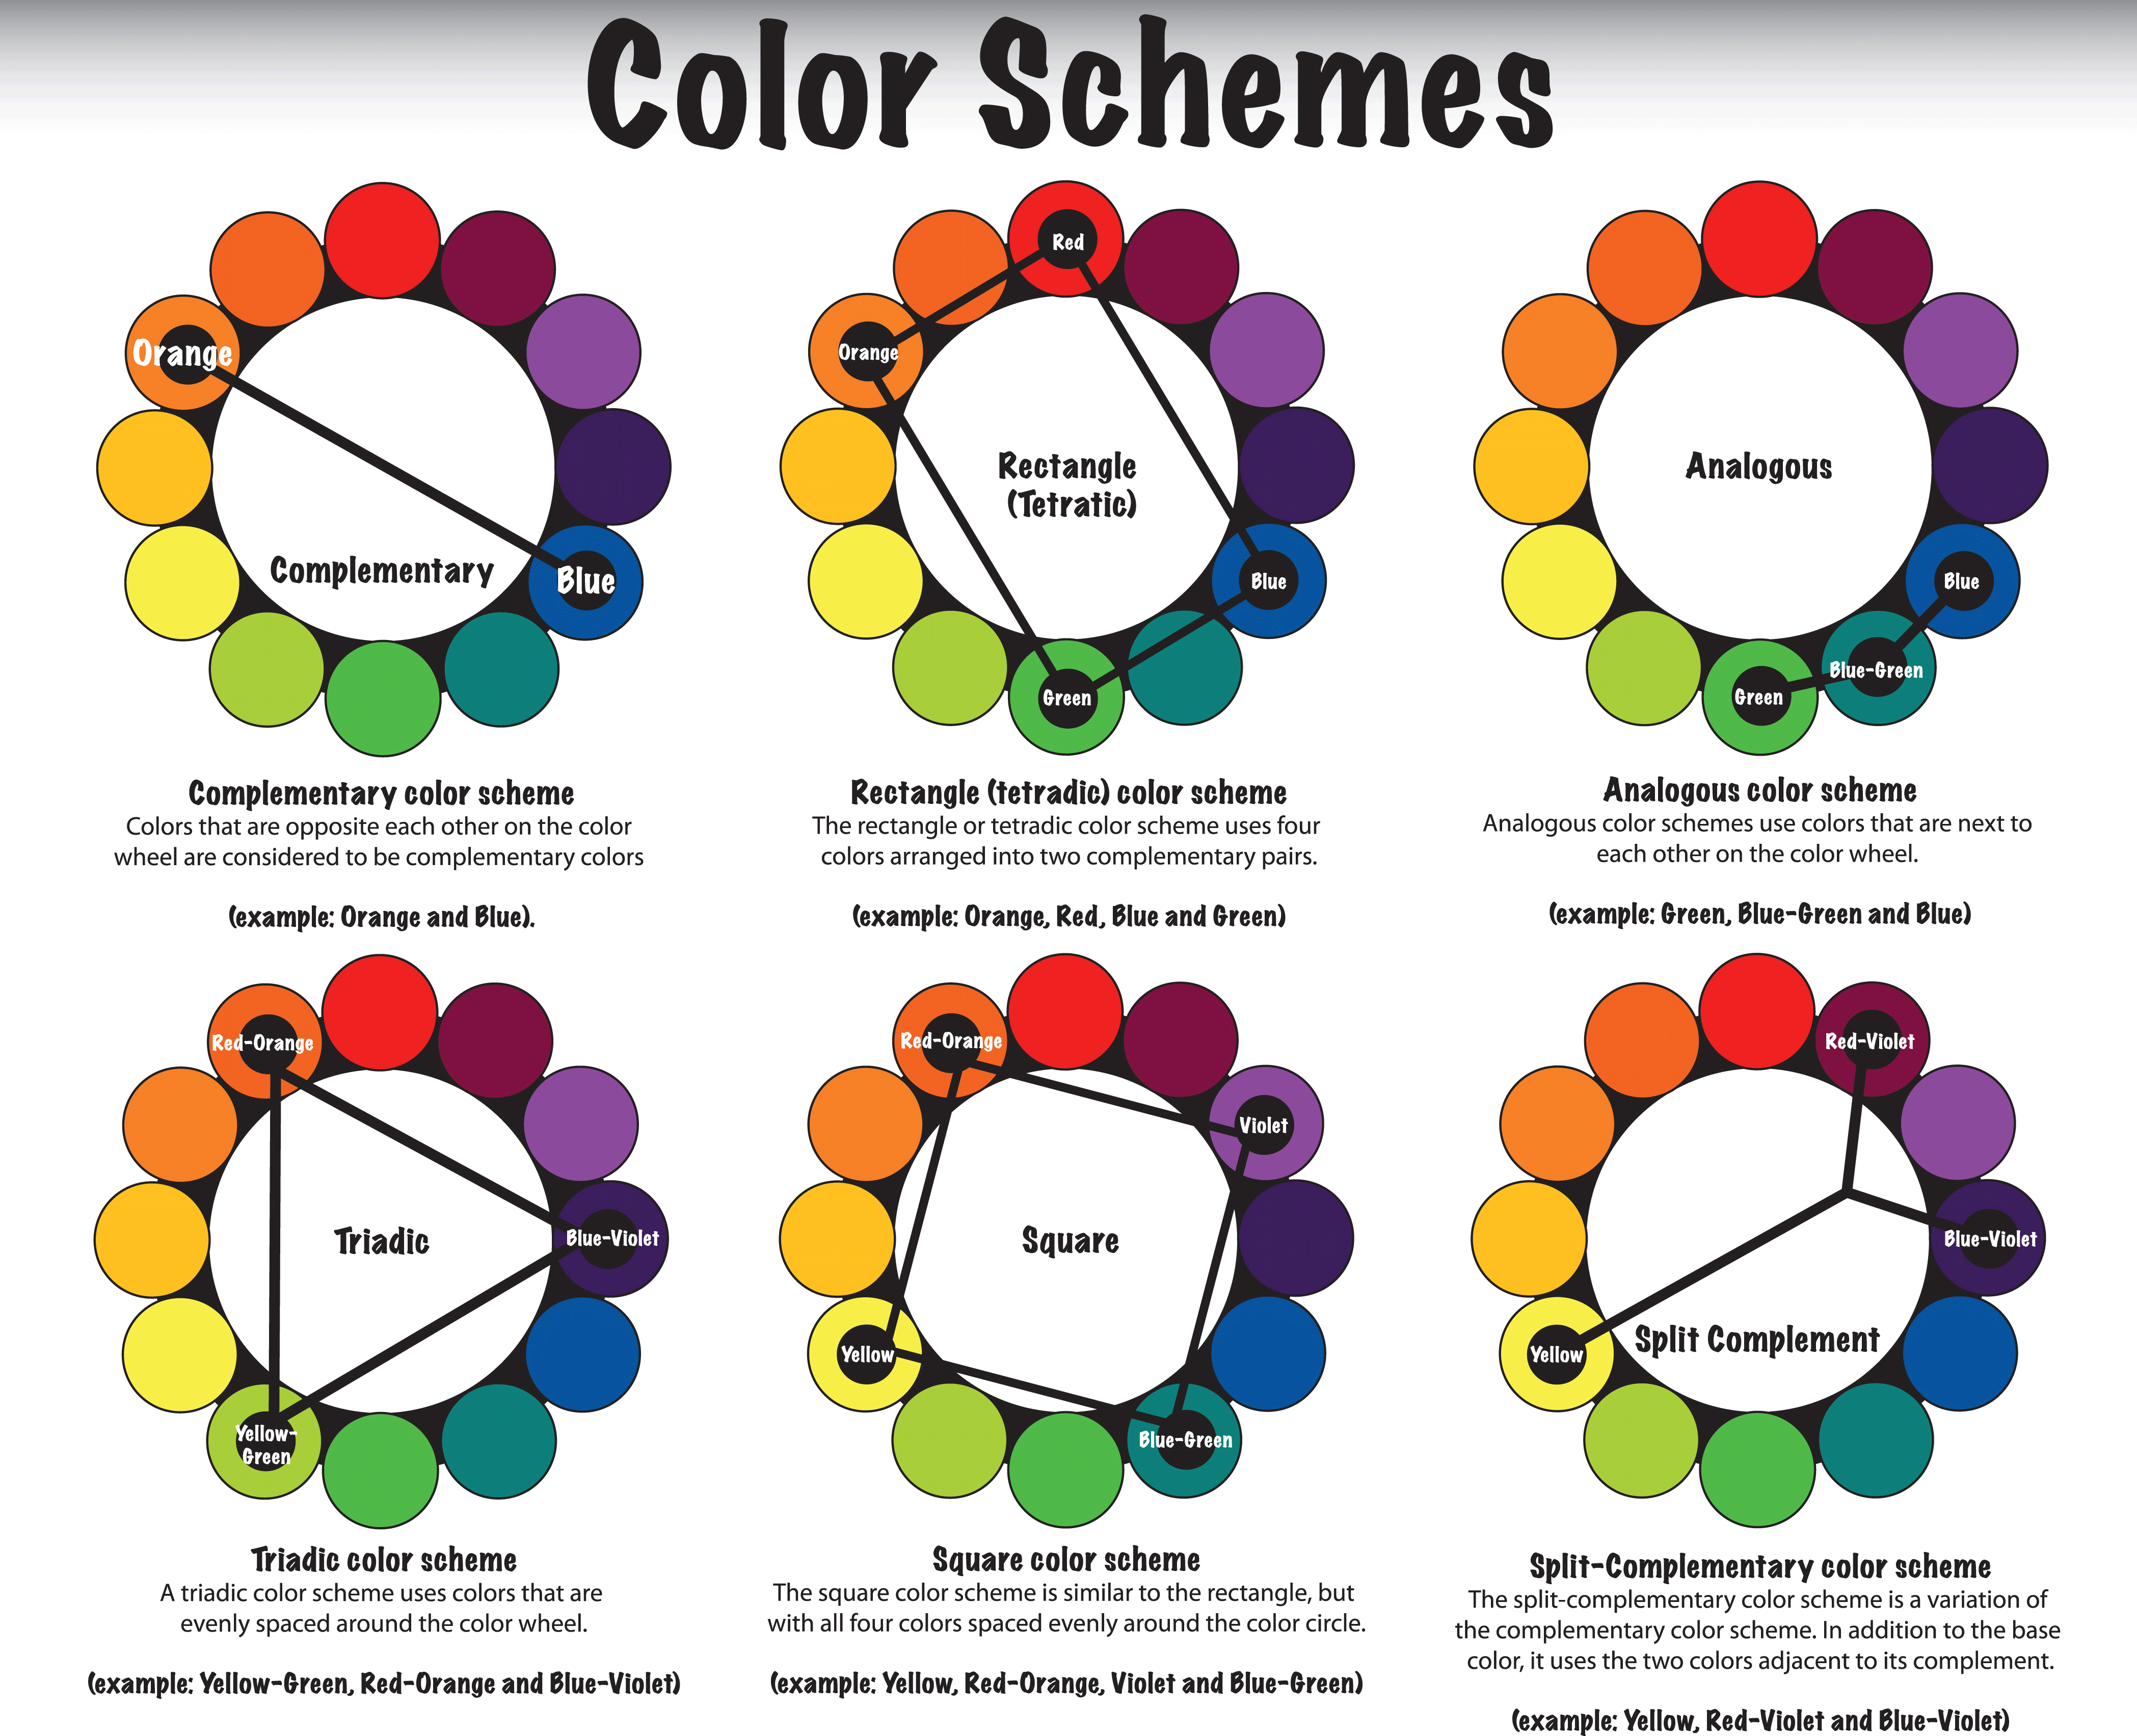
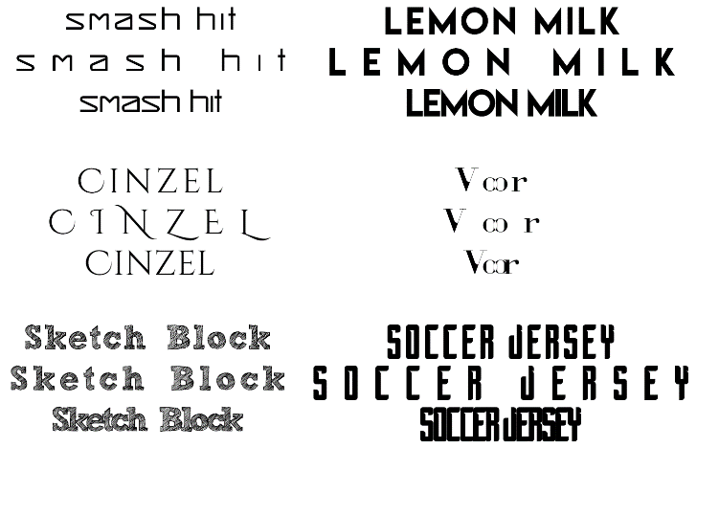
Research
Demographic - Males 18-24

Slide 6
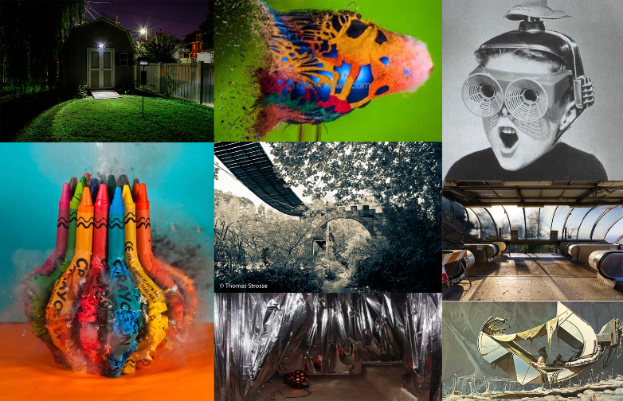
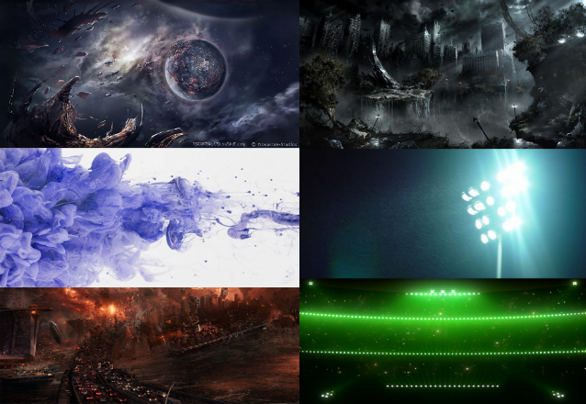


Research

Slide 7
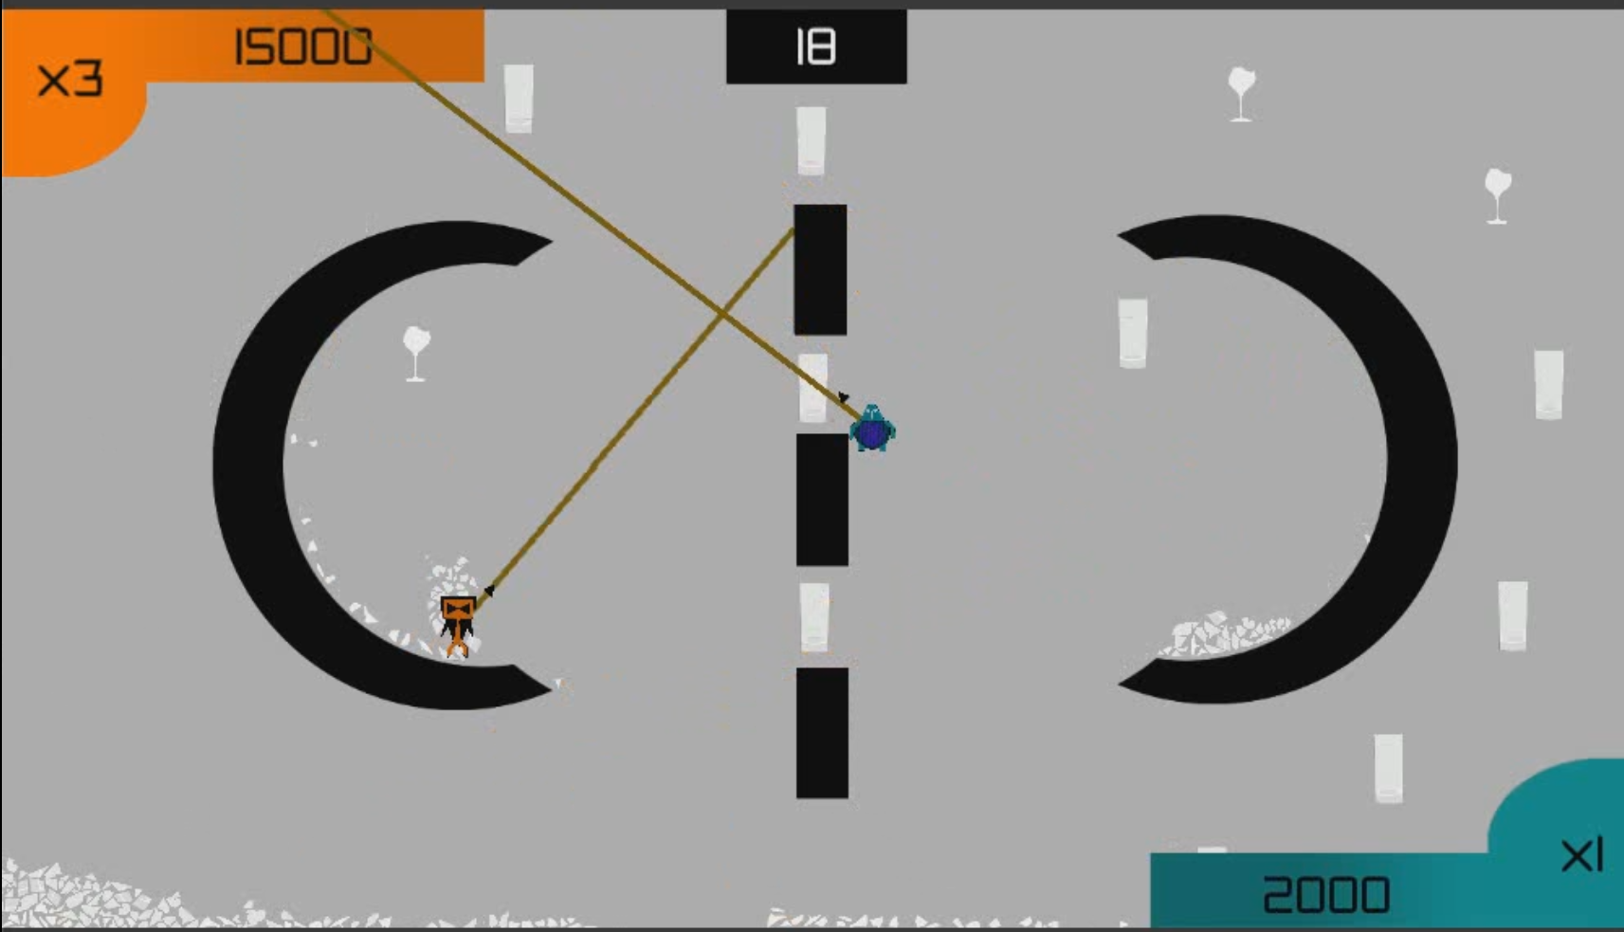
The Game

Slide 8
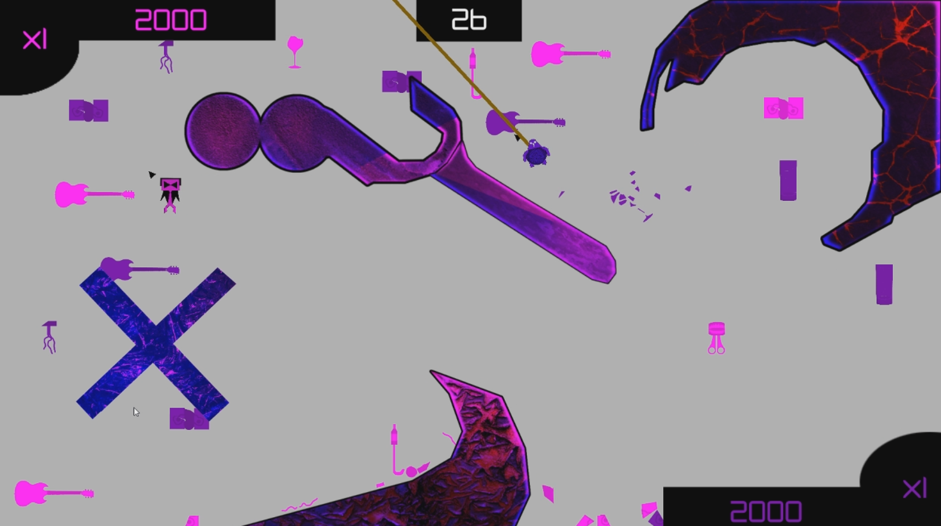
Mechanics
Physics
Swinging / Propelling
Twitch Movement
Limited Time
Fast Paced
Difficult Jumps

Slide 9








Gameplay
Fire
Fire
Aim
Aim

Slide 10
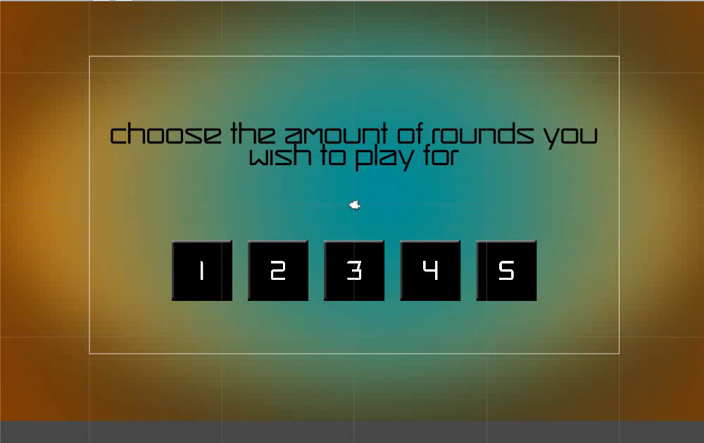
Gameplay Video
https://youtu.be/4ihYJWfBjuE

Slide 11
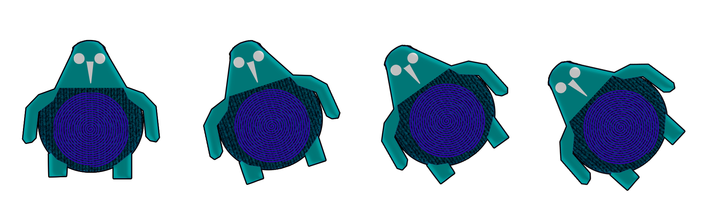

Alignment With The Brief
Physics Mechanics
Swinging / Propelling
Destroying Objects
Adversarial
Two Player Gameplay
Symmetrical Arenas
Single Screen

Slide 12
Playtesting / Feedback
Volunteer Males Aged 18-27
“It’s hard to see where you are aiming”
“I got stuck in the bottom left”
“I don’t understand the game’s theme”
X
✔
“Destroying the objects is fun”
“I could see myself playing this with my friends”

Slide 13
Next Steps…
Theme
Playtest
Round Times
Map Design
Pace
Identify Bugs/Issues
Polish
Sound Effects
Scene Transitions

Slide 14
Thank You For Listening
Questions/Feedback?

